Slide 1
Lecture 9: Pointer
Dr. Tsung-Wei Huang
Department of Electrical and Computer Engineering
University of Utah, Salt Lake City, UT
Notes:
Morning everyone
Today we are looking into control flow in C++.

Slide 2
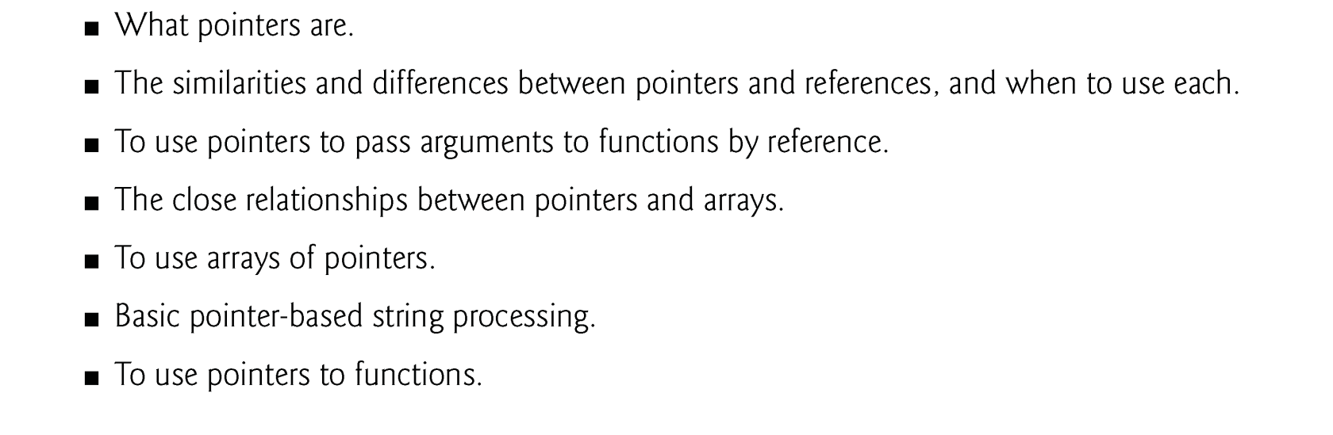
Learning Objective

Slide 3
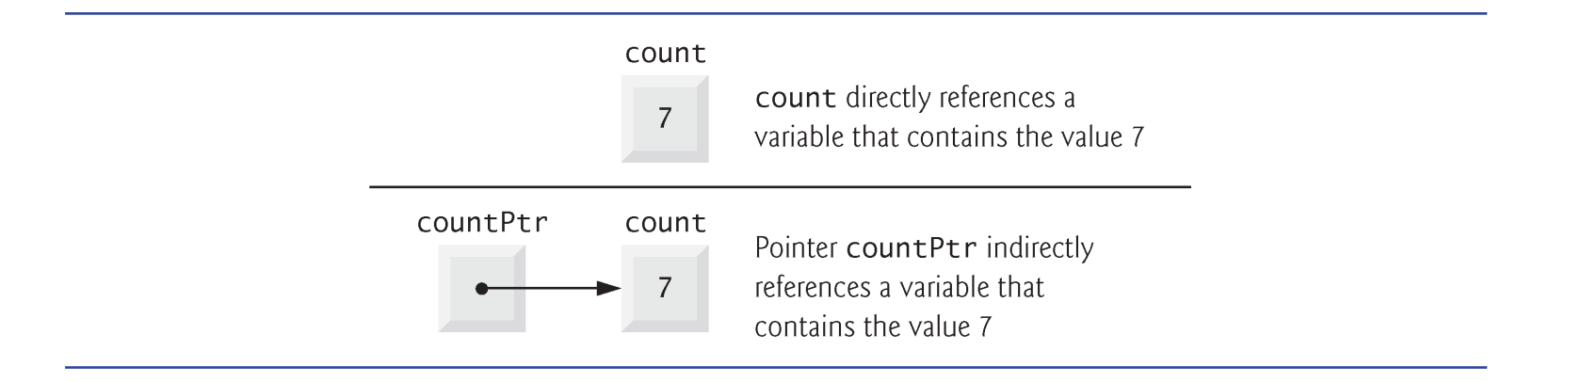
Introduction
A pointer contains the memory address of a variable.
The variable name directly references a value, and a pointer indirectly references a value.
Referencing a value through a pointer is called indirection.

Slide 4
Declaring a Pointer
The declaration
int *countPtr, count;
declares the variable countPtr to be of type int * (i.e., a pointer to an int value)
Read as “countPtr is a pointer to int.”
Variable count in the preceding declaration is declared to be an int, not a pointer to an int.
Each variable being declared as a pointer must be preceded by an asterisk (*).
When * appears in a declaration, it isn’t an operator; rather, it indicates that the variable being declared is a pointer.
Pointers can be declared to point to objects of any data type.

Slide 5
Value of a Pointer
Pointers should be initialized either when they’re declared or in an assignment.
A pointer may be initialized to 0, NULL or an address of the corresponding type.
A pointer with the value 0 or NULL points to nothing and is known as a null pointer.
The value 0 is the only integer value that can be assigned directly to a pointer variable.

Slide 6
Pointer Operator
The address operator (&) is a unary operator that obtains the memory address of its operand.
Cannot be applied to constants or to expressions that do not result in references
Assuming the declarations
int y = 5; // declare variable y int *yPtr; // declare pointer variable yPtr
the following statement assigns the address of the variable y to pointer variable yPtr.
yPtr = &y; // assign address of y to yPtr

Slide 7
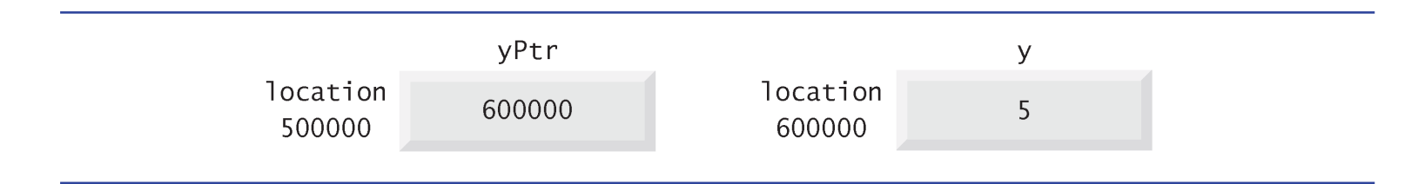
Pointer Operator (cont’d)
Assume the integer variable y stored at memory location 600000 and pointer variable yPtr stored at memory location 500000.
The * operator, commonly referred to as the indirection operator or dereferencing operator, returns a synonym for the object to which its pointer operand points.
Called dereferencing a pointer
yPtr = 600000; *yPtr = 5;

Slide 8
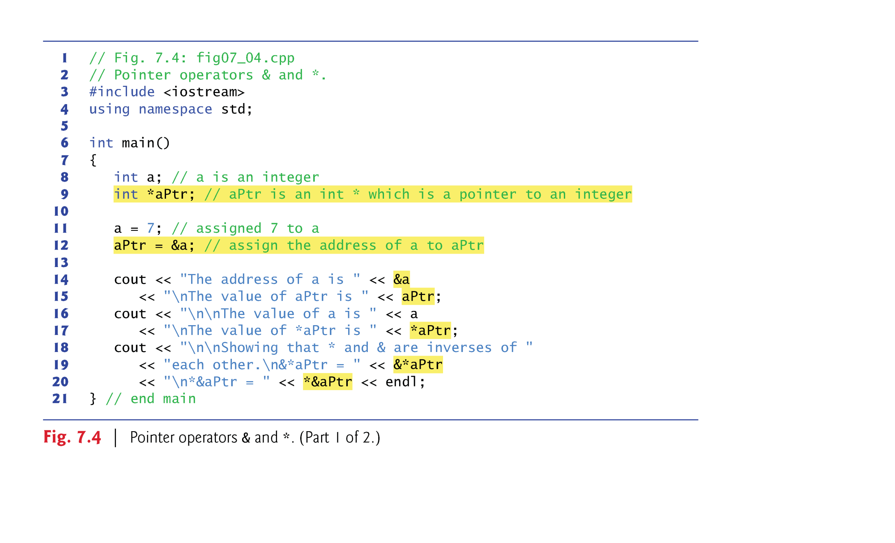
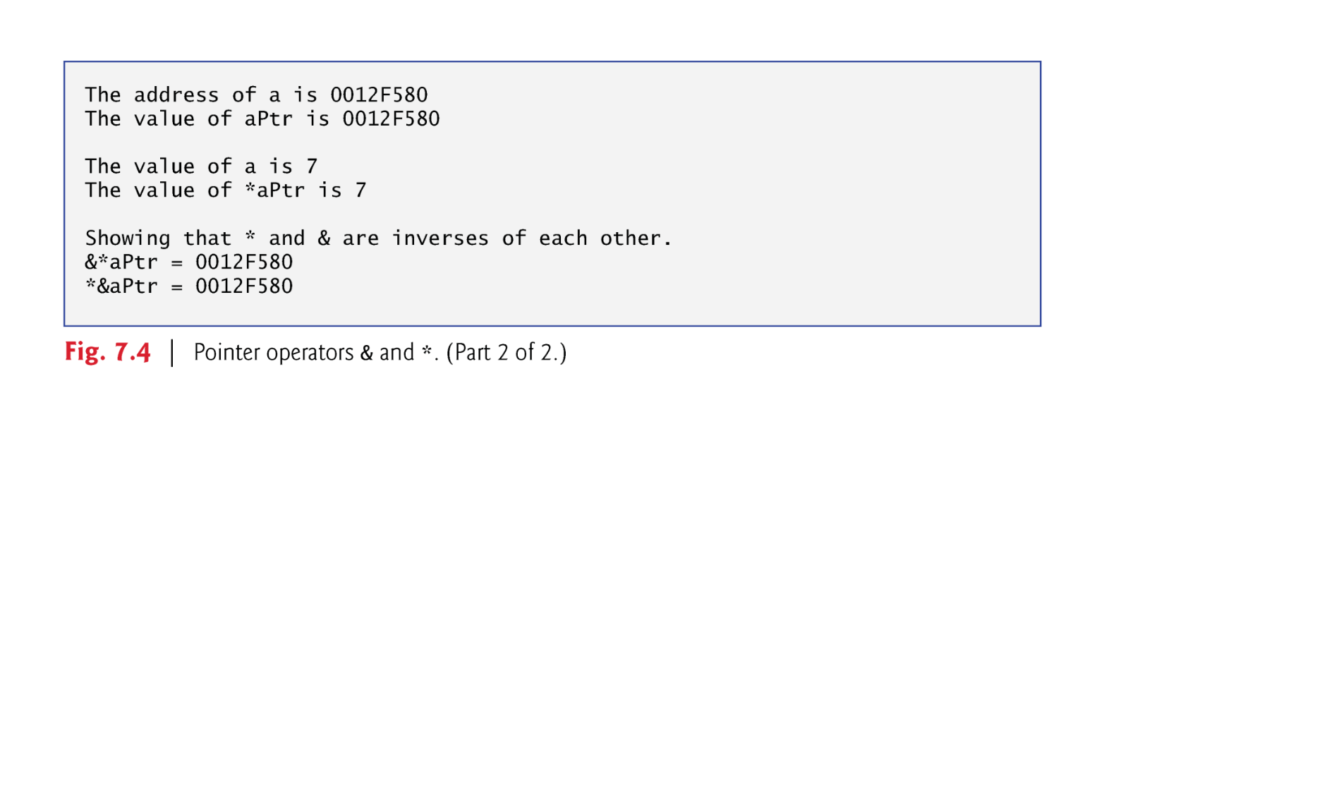
Example
The & and * operators are inverses of one another.

Slide 9
Pass by Pointer (address)
There are three ways in C++ to pass arguments to a function—pass-by-value, pass-by-reference with reference arguments and pass-by-reference with pointer arguments.
We explain pass-by-reference with pointer arguments (pass by pointer)
Pointers, like references, can be used to modify the variables in the caller or to pass pointers to large data objects to avoid the overhead of being passed by value.
In C++, you can use pointers and the indirection operator (*) to accomplish pass-by-reference.

Slide 10
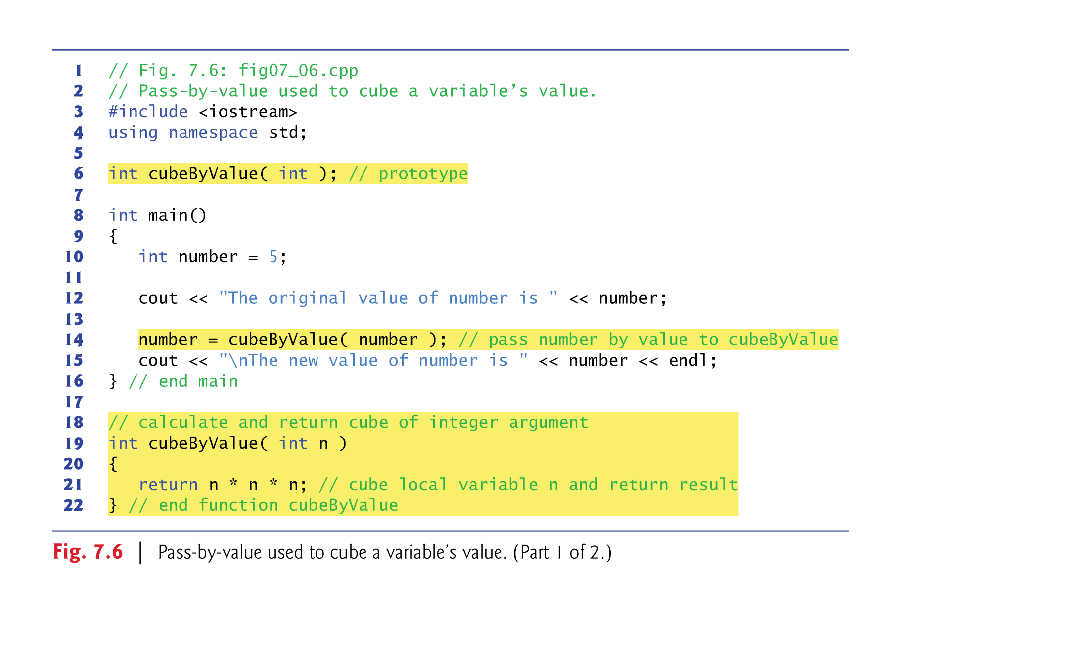
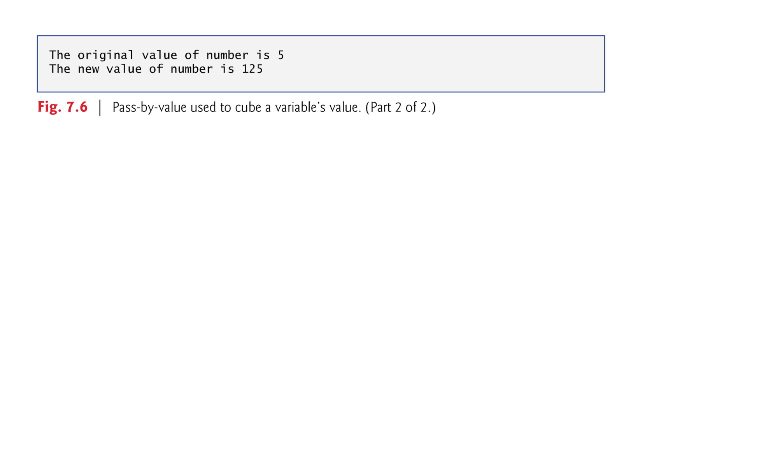
Recap: Call By Value

Slide 11
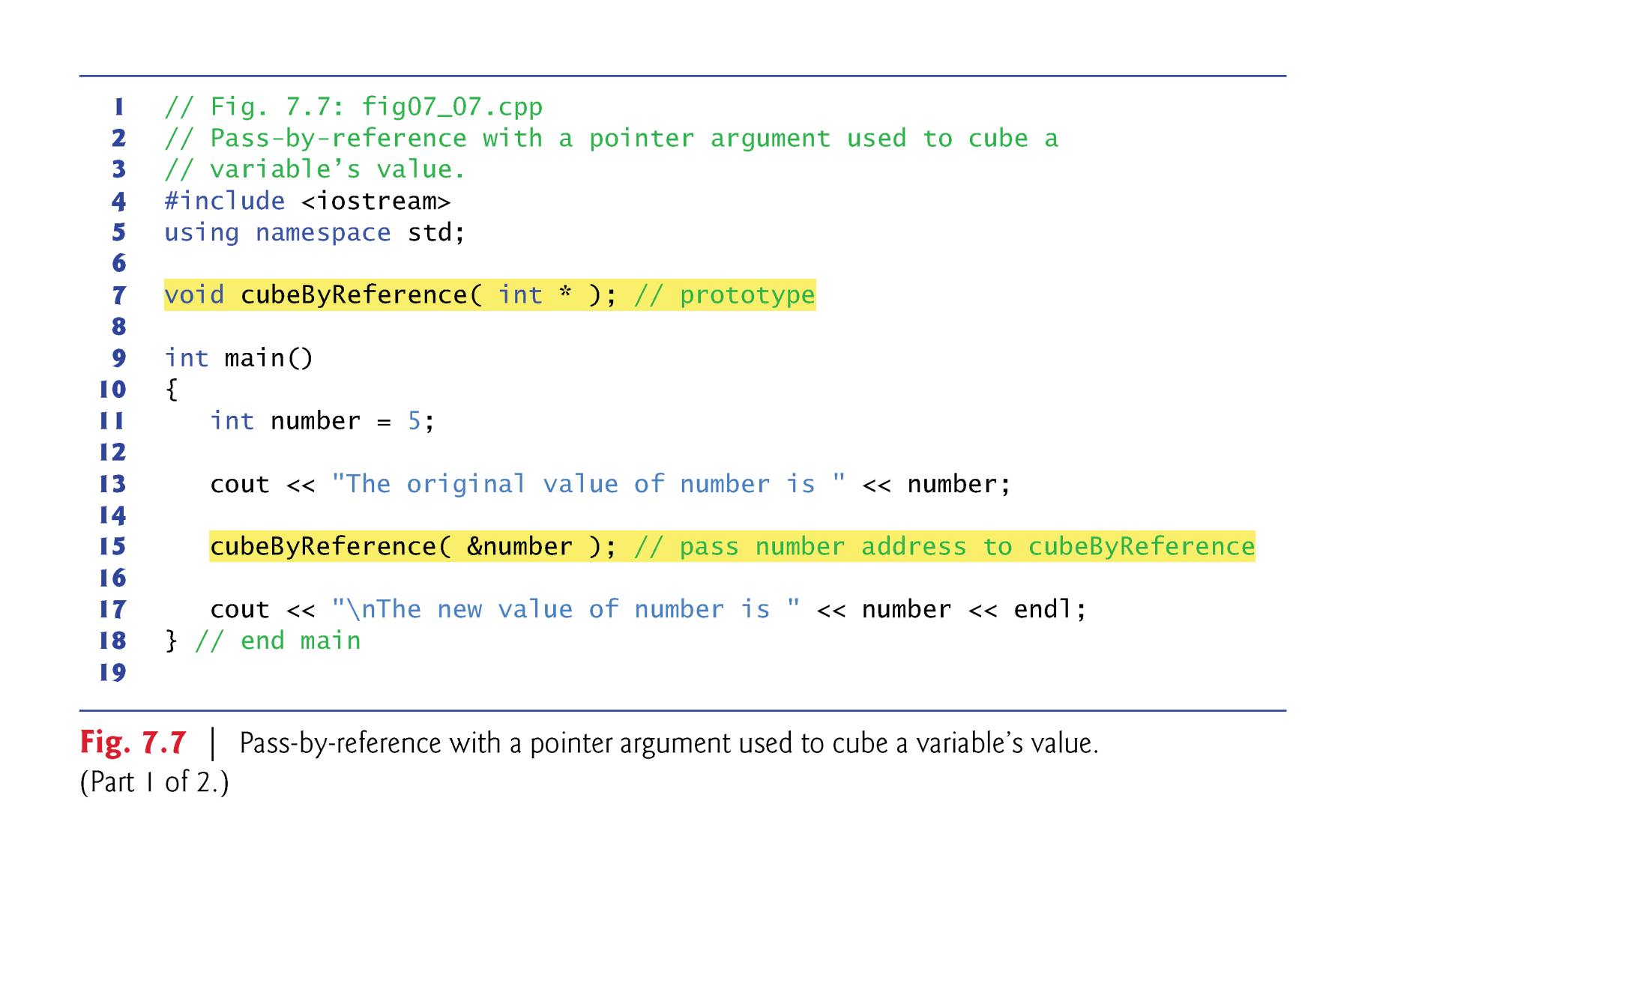
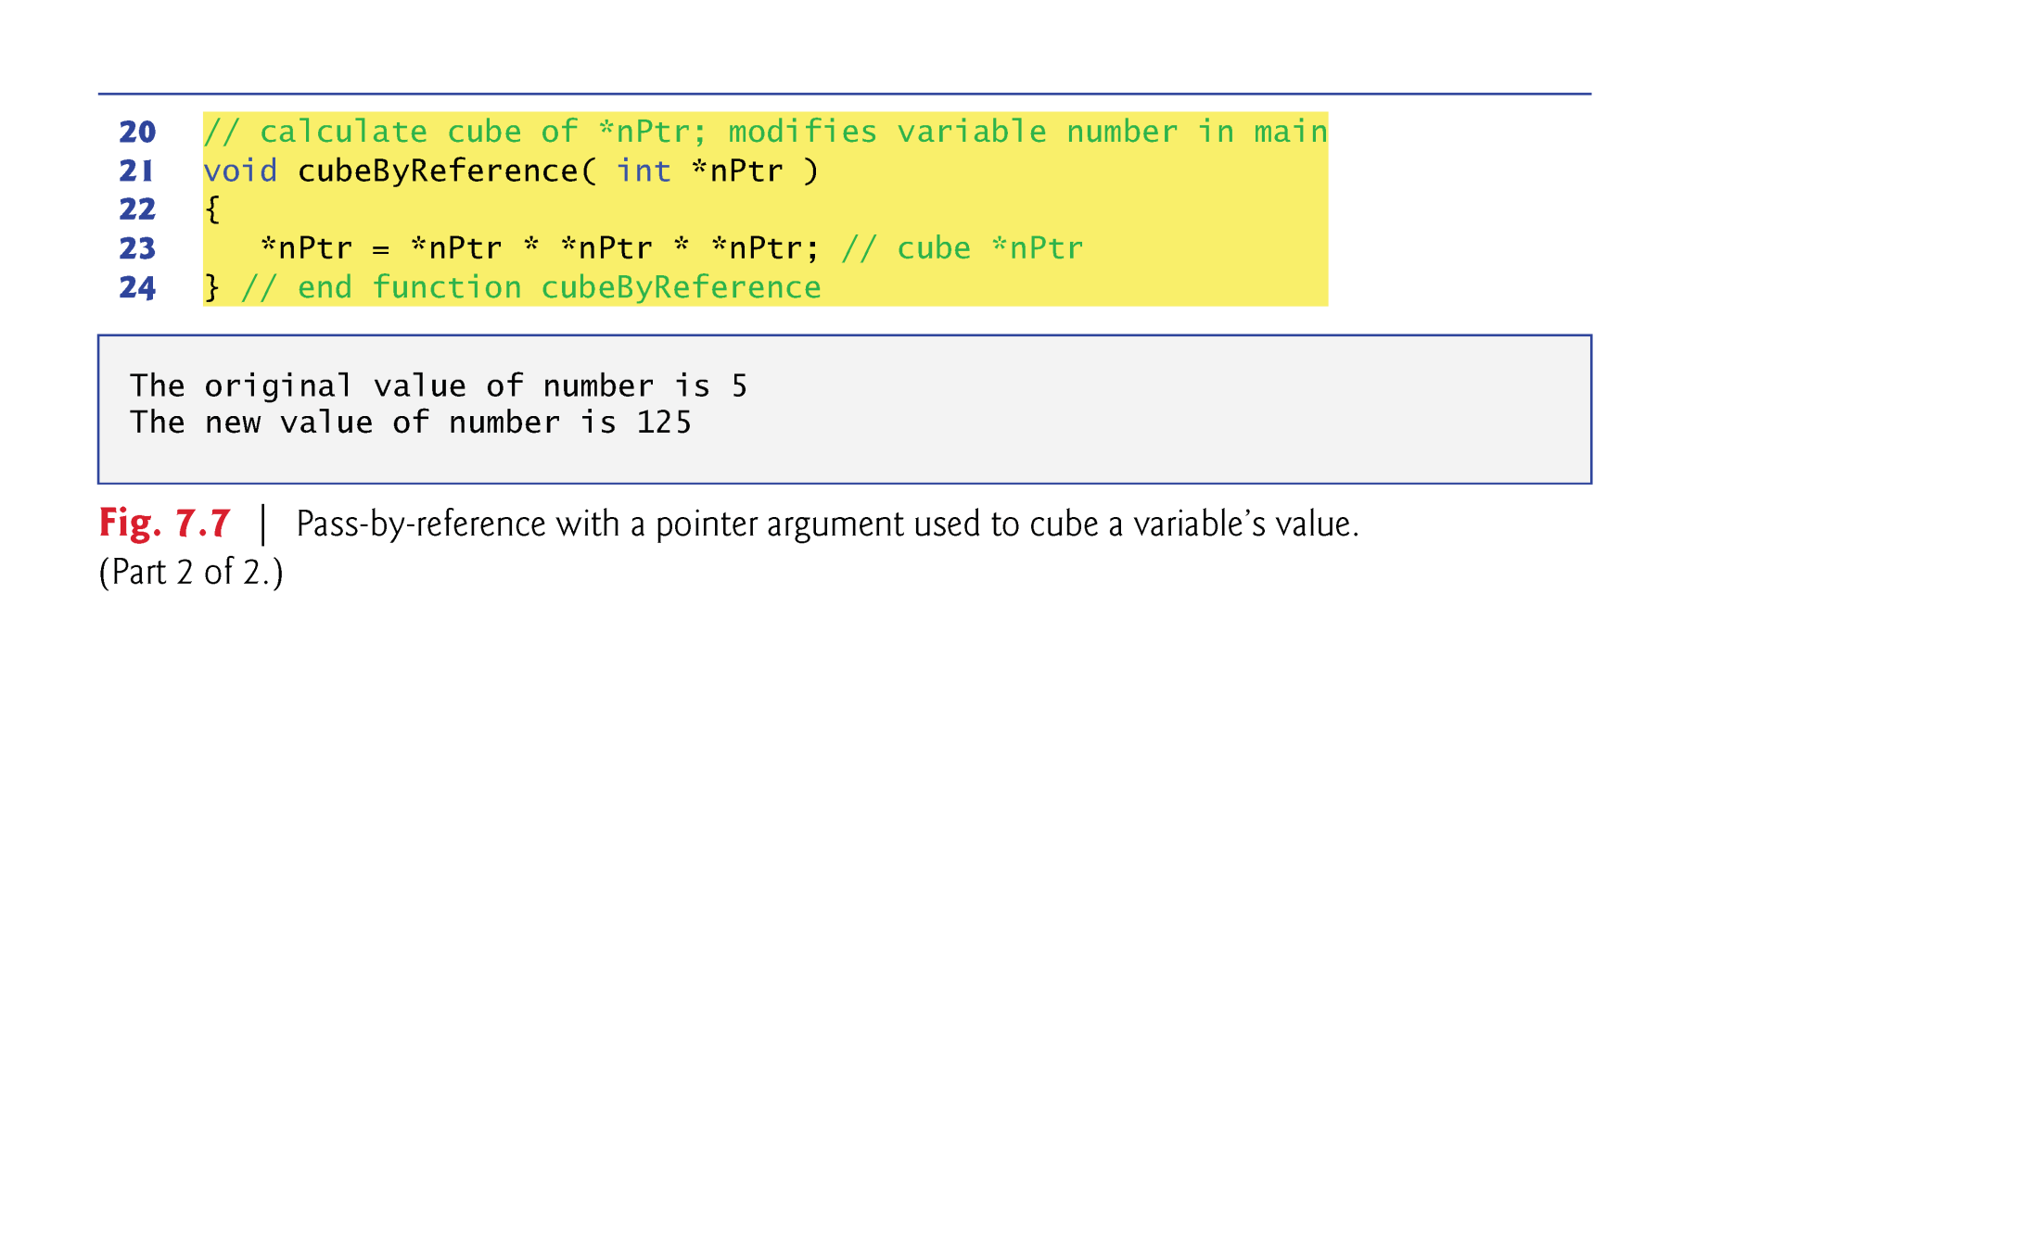
How to do it with Call by Pointer?

Slide 12
Using const with Pointer
A nonconstant pointer to nonconstant data
ex: int *myPtr = &x;
Both the address and the data can be changed
A nonconstant pointer to constant data (Fig. 7.10)
ex: const int *myPtr = &x;
Modifiable pointer to a const int (data are not modifiable)
A constant pointer to nonconstant data (Fig. 7.11)
ex: int *const myPtr = &x;
Constant pointer to an int (data can be changed, but the address cannot)
A constant pointer to constant data (Fig. 7.12)
ex: const int *const Ptr = &x;
Both the address and the data are not modifiable

Slide 13
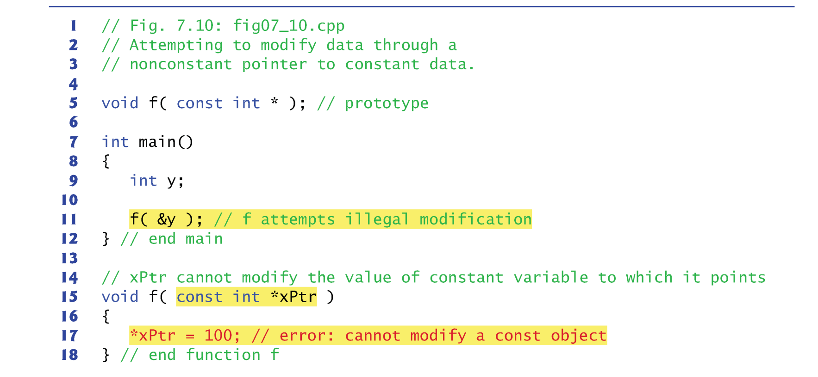
Example of const pointer

Slide 14
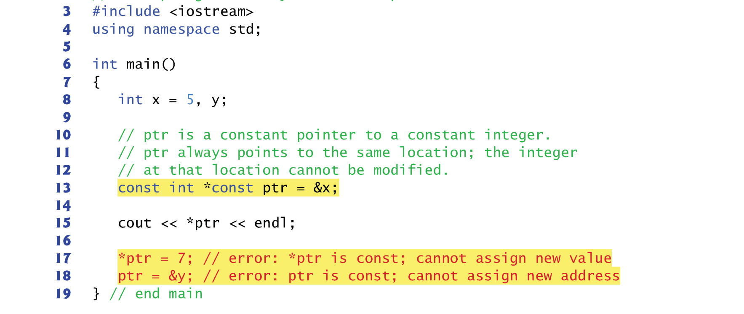
Example of const pointer

Slide 15
Pointer Expression and Arithmetic
Pointers are valid operands in arithmetic expressions, assignment expressions and comparison expressions.
pointer arithmetic—certain arithmetic operations may be performed on pointers:
increment (++)
decremented (--)
an integer may be added to a pointer (+ or +=)
an integer may be subtracted from a pointer (- or -=)
one pointer may be subtracted from another of the same type

Slide 16
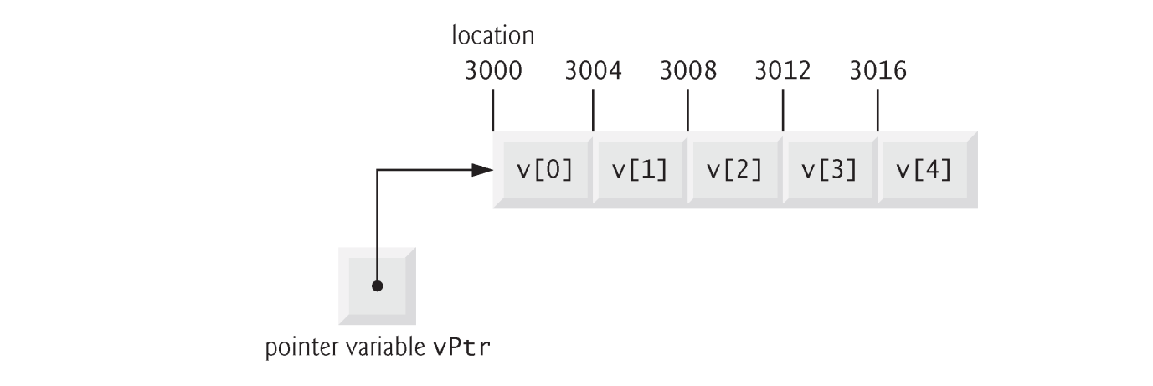
Pointer Expression and Arithmetic
Assume that array int v[5] has been declared and that its first element is at memory location 3000.
Assume that pointer vPtr has been initialized to point to v[0] (i.e., the value of vPtr is 3000).

Slide 17

Pointer Expression and Arithmetic
In conventional arithmetic, the addition 3000 + 2 yields the value 3002.
Not true for pointer arithmetic
When an integer is added to, or subtracted from, a pointer, the pointer is incremented or decremented by that integer times the size of the object to which the pointer refers
The number of bytes depends on the object’s data type.

Slide 18
Pointer Expression and Arithmetic
Pointer variables pointing to the same array may be subtracted from one another.
For example, if vPtr contains the address 3000 and v2Ptr contains the address 3008, the statement
x = v2Ptr - vPtr;
would assign to x the number of array elements from vPtr to v2Ptr—in this case, 2.
Pointer arithmetic is meaningless unless performed on a pointer that points to an array.

Slide 19
sizeof Operator
The unary operator sizeof determines the size of an array (or of any other data type, variable or constant) in bytes during program compilation.
When applied to the name of an array, the sizeof operator returns the total number of bytes in the array as a value of type size_t.
When applied to a pointer parameter in a function that receives an array as an argument, the sizeof operator returns the size of the pointer in bytes—not the size of the array.

Slide 20
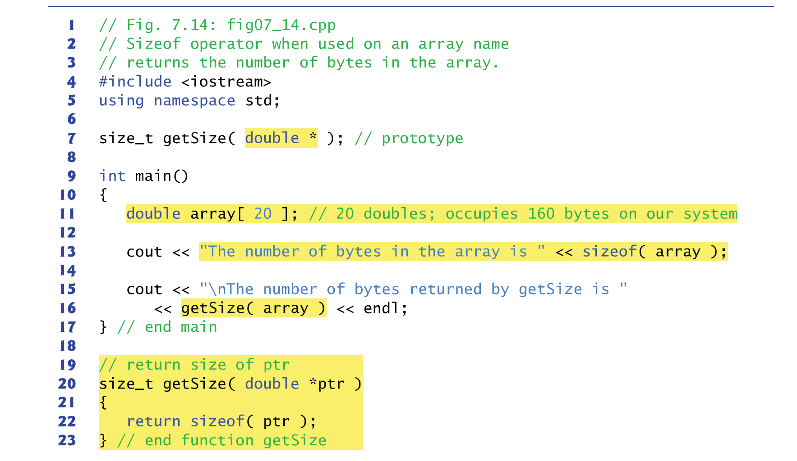
Example

Slide 21
sizeof Operator
The number of elements in an array also can be determined using the results of two sizeof operations.
Consider the following array declaration:
double realArray[ 22 ];
To determine the number of elements in the array, the following expression (which is evaluated at compile time) can be used:
sizeof realArray / sizeof( realArray[ 0 ] )
The expression determines the number of bytes in array realArray and divides that value by the number of bytes used in memory to store the array’s first element.

Slide 22
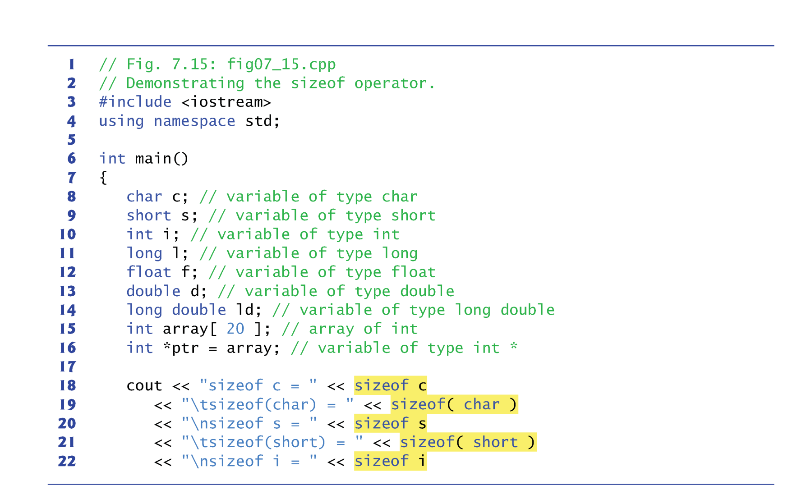
Bytes of Types

Slide 23
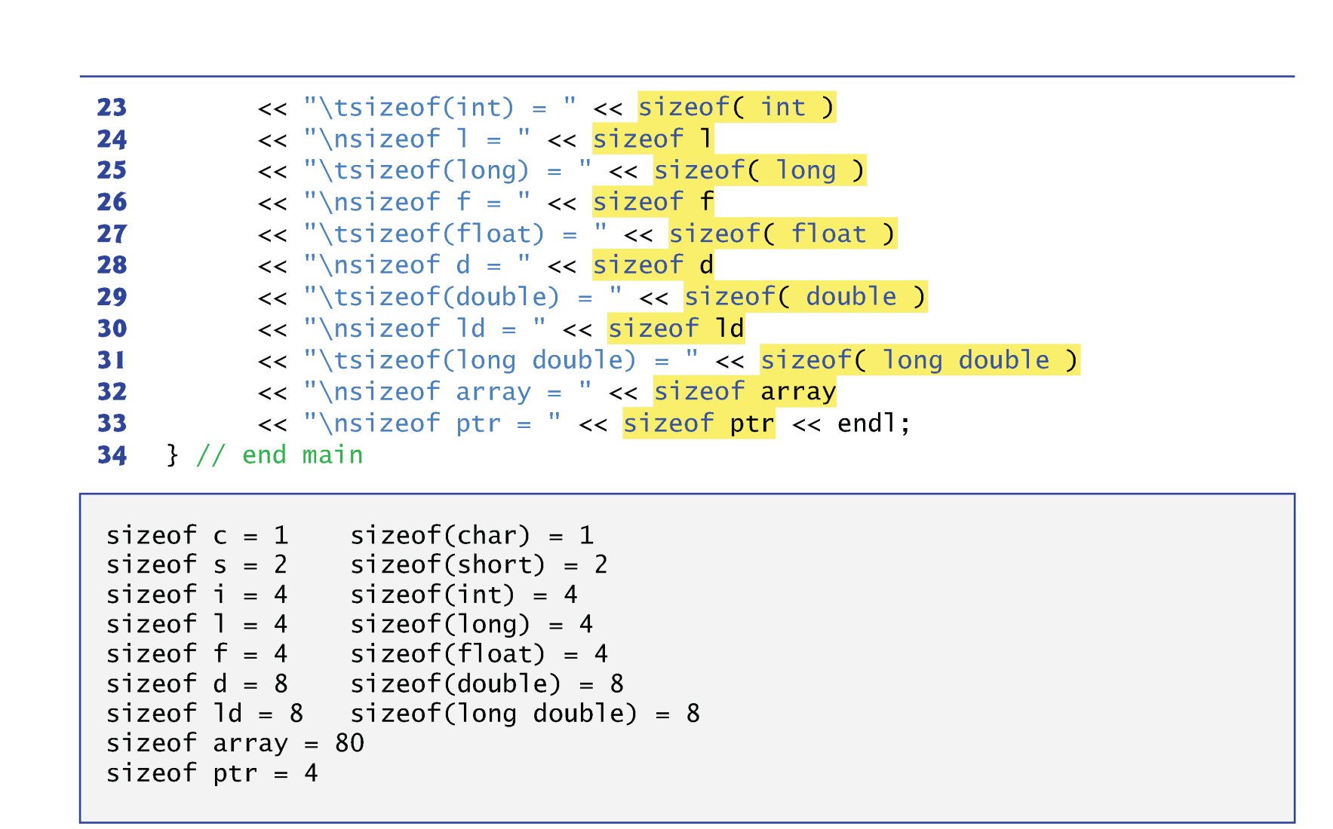
Bytes of Types

Slide 24
Relationship between Pointers and Array
The array name (without a subscript) is a constant pointer to the first element of the array.
Although it’s a pointer, it cannot be modified in arithmetic expressions.
Pointers can be used to do any operation involving array subscripting.
Assume the following declarations:
int b[ 5 ]; // create 5-element int array b int *bPtr; // create int pointer bPtr
We can set bPtr to the address of the first element in array b with the statement
bPtr = b; // assign address of array b to bPtr
equivalent to
bPtr = &b[ 0 ]; // also assigns address of array b to bPtr

Slide 25
Relationship between Pointers and Array
Array element b[ 2 ] can alternatively be referenced with the pointer expression
*( bPtr + 2 )
The 2 in the preceding expression is the offset to the pointer.
This notation is referred to as pointer/offset notation.
The parentheses are necessary, because the precedence of * is higher than that of +.

Slide 26
Relationship between Pointers and Array
Pointers can be subscripted exactly as arrays can.
For example, the expression bPtr[ 1 ] refers to the array element b[ 1 ]; this expression uses pointer/ subscript notation.
In this section, four notations are discussed for referring to array elements to accomplish the same task :
Array subscript notation,
Pointer/offset notation with the array name as a pointer,
Pointer subscript notation, and
Pointer/offset notation with a pointer

Slide 27
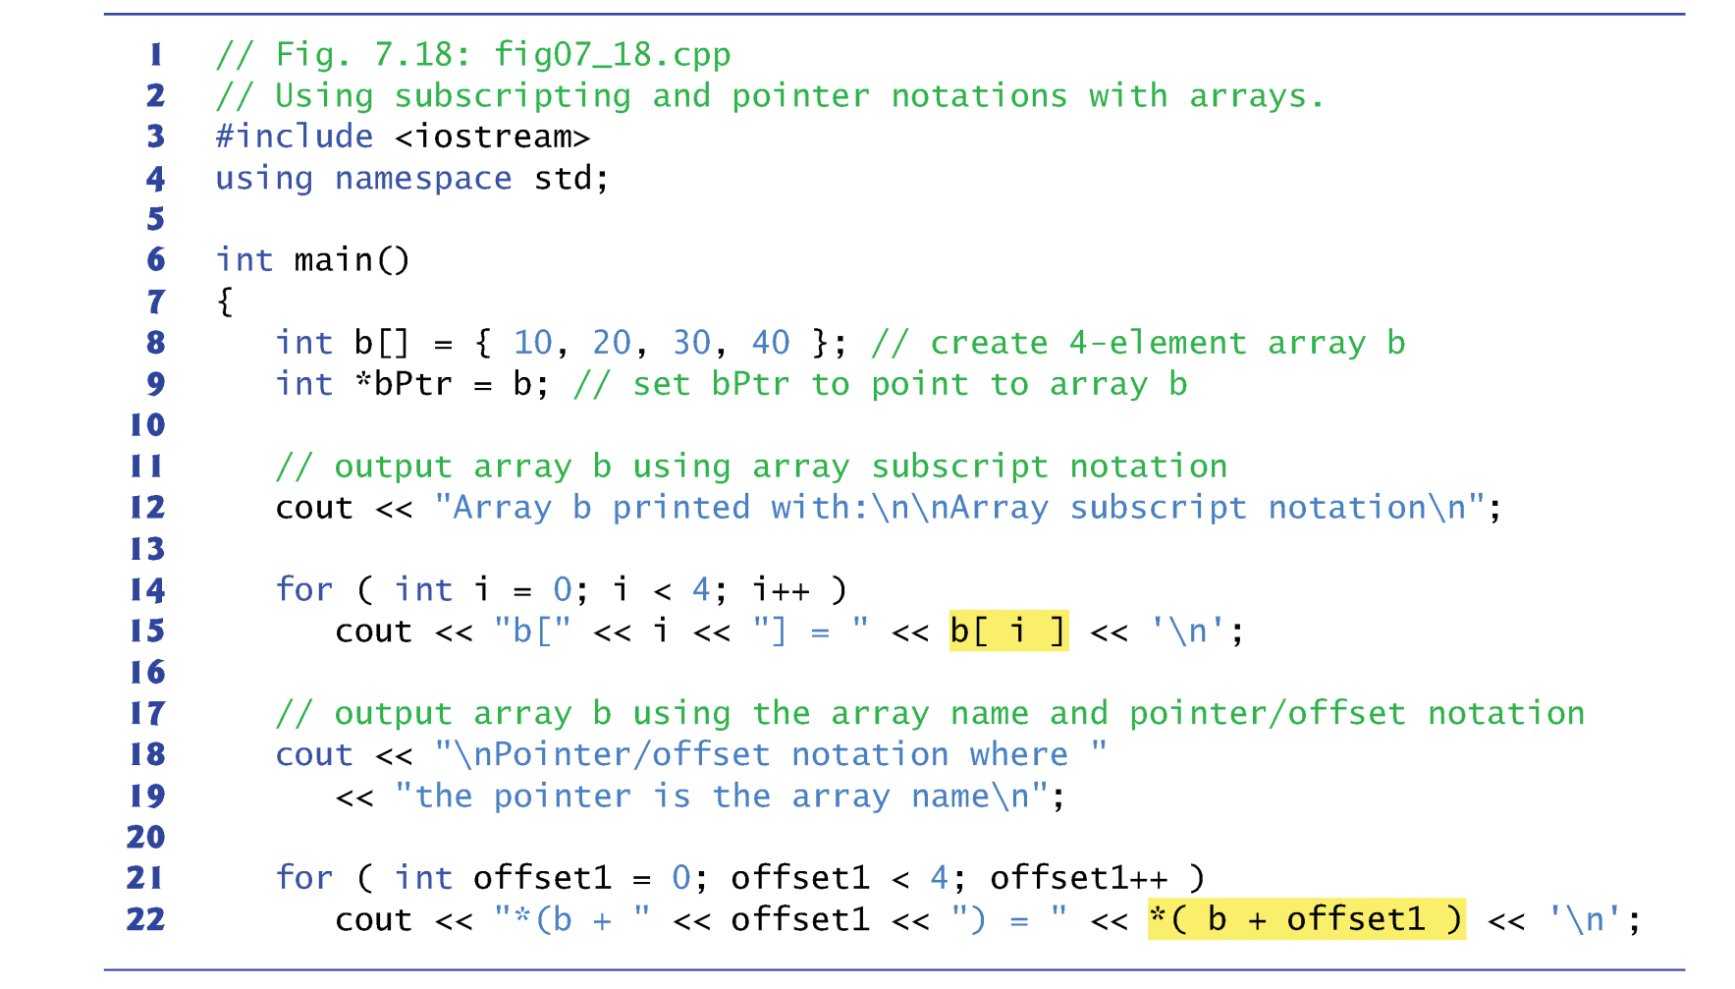
Relationship between Pointers and Array

Slide 28
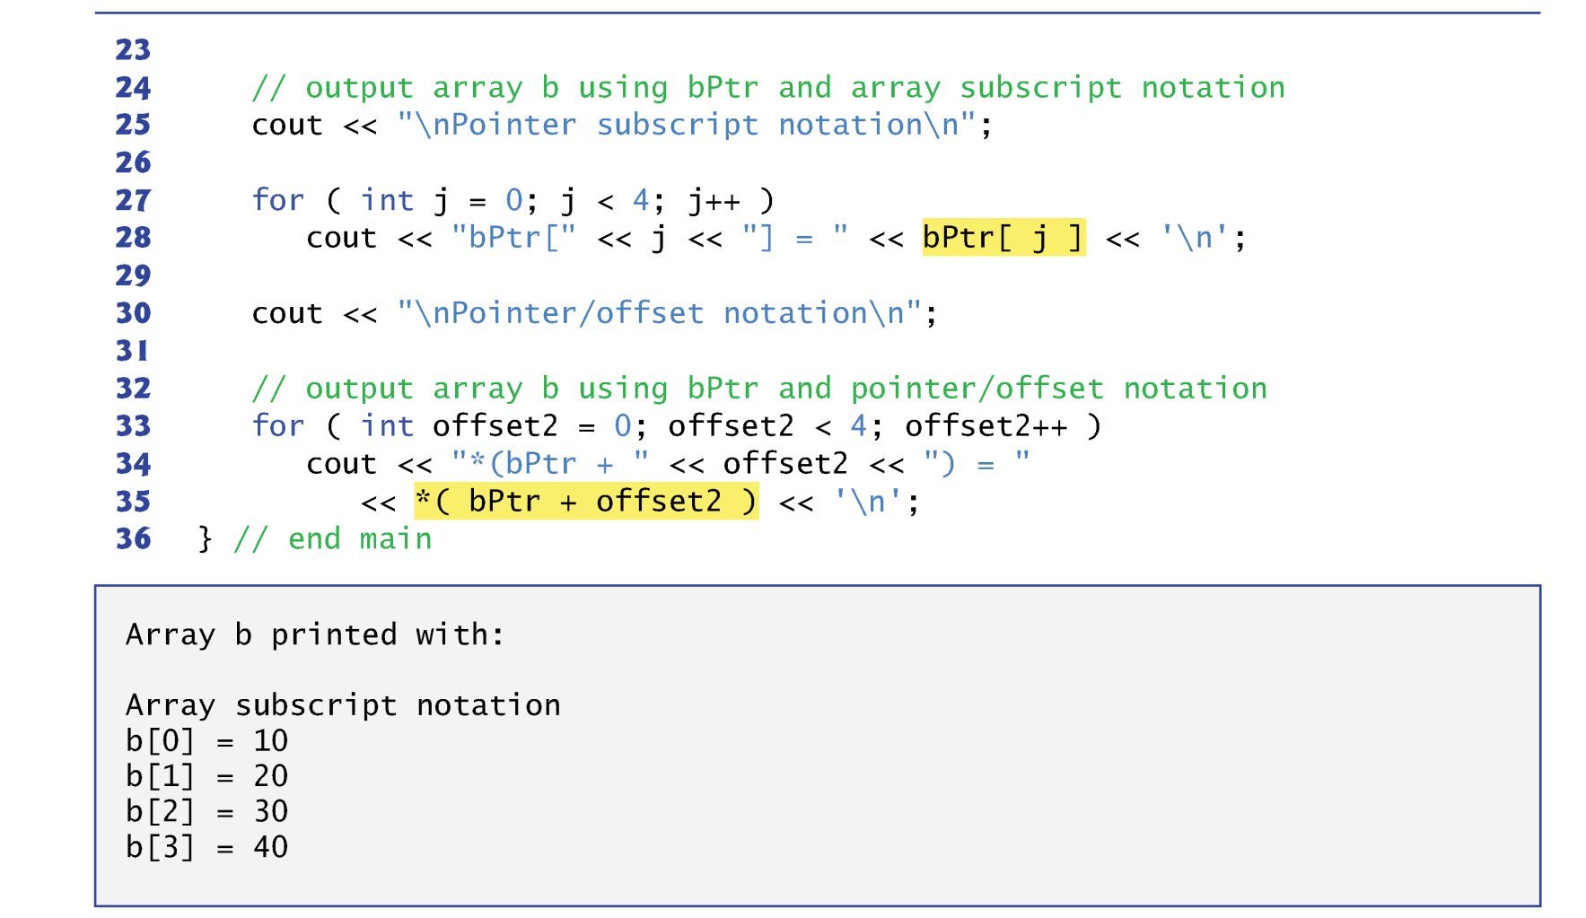
Relationship between Pointers and Array

Slide 29
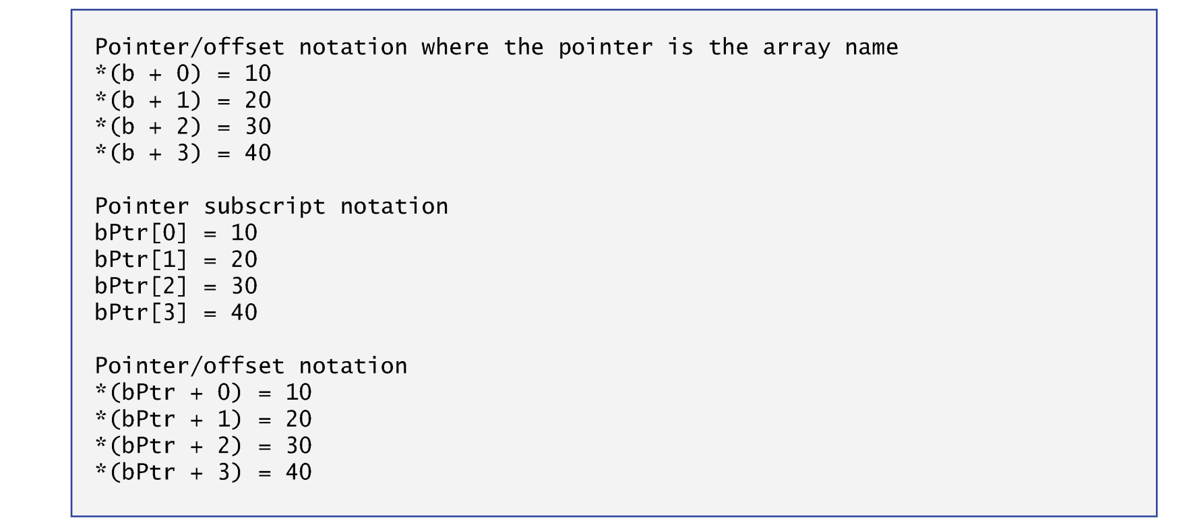
Relationship between Pointers and Array

Slide 30
Pointer-based String
Character constant
An integer value represented as a character in single quotes.
The value of a character constant is the integer value of the character in the machine’s character set.
A string is a series of characters treated as a single unit.
May include letters, digits and various special characters such as +, -, *, /and $.
String literals, or string constants, in C++ are written in double quotation marks
A pointer-based string is an array of characters ending with a null character ( \0 ).
Ex: “happy” → ‘h’, ‘a’, ‘p’, ‘p’, ‘y’, ‘\0’

Slide 31
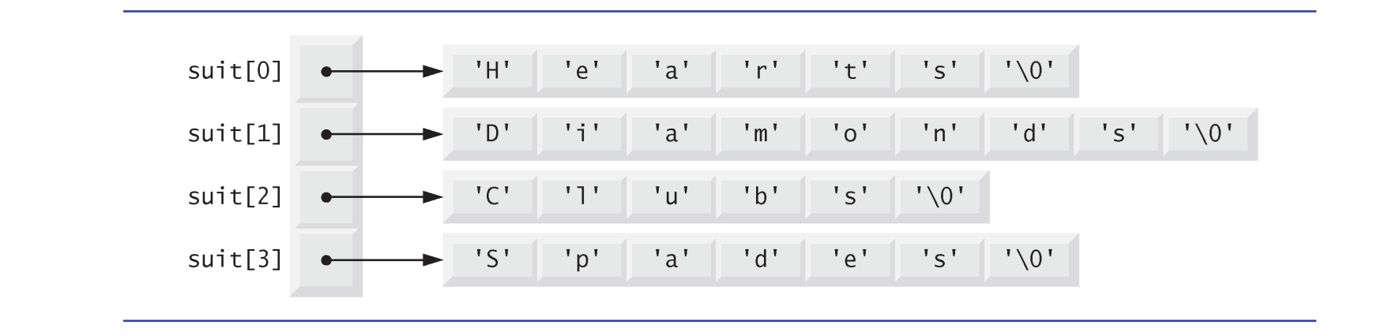
Pointer-based String
cout << suit[0]; → print out “Hearts”
cout << suit[2]; → print out “Clubs”
What will be printed by the following program?
for (int i=0; i<10; i++) {
idx = rand()%4;
cout << suit[idx];
}

Slide 32
Memory Layout
Stack vs Heap

Slide 33
Stack
The place where arguments of a function call are stored
The place where registers of the calling function are saved
The place where local data of called function is allocated
Automatic data
The place where called function leaves result for calling function
Supports recursive function calls
…

Slide 34
Stack
Imagine the following program:–
int factorial(int n){
if (n <= 1)
return (1);
else
int y = factorial(n-1);
return (y * n);
}
Imagine also the caller:–
int x = factorial(100);
What does compiled code look like?

Slide 35
Compiled Code: Caller
int x = factorial(100);
Put the value “100” somewhere that factorial function can find
Put the current program counter somewhere so that factorial function can return to the right place in calling function
Provide a place to put the result, so that calling function can find it

Slide 36
Compiled Code: Factorial Function
Save the caller’s registers somewhere
Get the argument n from the agreed-upon place
Set aside some memory for local variables and intermediate results – i.e., y, n - 1
Do whatever factorial was programmed to do
Put the result where the caller can find it
Restore the caller’s registers
Transfer back to the program counter saved by the caller

Slide 37
Somewhere?
So that caller can provide as many arguments as needed (within reason)?
So that called routine can decide at run-time how much temporary space is needed?
So that called routine can call any other routine, potentially recursively?

Slide 38
Answer: a Stack
Stack – a linear data structure in which items are added and removed in last-in, first-out order.
Calling program
Push arguments & return address onto stack
After return, pop result off stack

Slide 39
Stack with Called Routine
Called routine
Push registers and return address onto stack
Push temporary storage space onto stack
Do work of the routine
Pop registers and temporary storage off stack
Leave result on stack
Return to address left by calling routine

Slide 40
Stack
All modern programming languages require a stack
Fortran and Cobol did not (non-recursive)
All modern processors provide a designated stack pointer register
All modern process address spaces provide room for a stack
Able to grow to a large size
May grow upward or downward

Slide 41
Heap
A place for allocating memory that is not part of last-in, first-out discipline
I.e., dynamically allocated data structures that survive function calls
E.g., strings in C
new objects in C++, Java, etc.

Slide 42
Allocate Memory from Heap
malloc() – POSIX standard function
Allocates a chunk of memory of desired size
Remembers size
Returns pointer
free () – POSIX standard function
Returns previously allocated chunk to heap for reallocation
Assumes that pointer is correct!

Slide 43
Allocate Memory from Heap
malloc() – POSIX standard function
Allocates a chunk of memory of desired size
Remembers size
Returns pointer
free () – POSIX standard function
Returns previously allocated chunk to heap for reallocation
Assumes that pointer is correct!
Storage leak – failure to free something

Slide 44
Heap in Modern Systems
Many modern programming languages require a heap
C++, Java, etc.
NOT Fortran
Typical process environment
Heap grows toward stack — but never shrinks!
Multi-threaded environments
All threads share the same heap
Data structures may be passed from one thread to another.

Slide 45
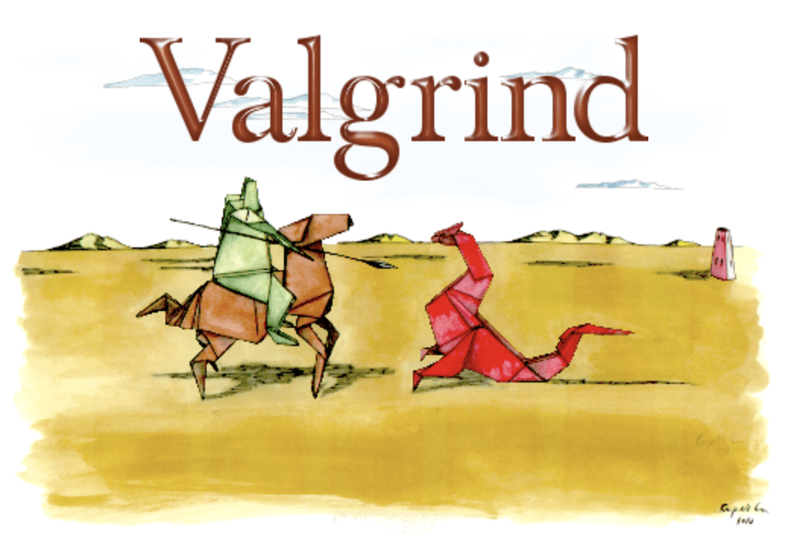
How to Detect Memory Leak?
https://valgrind.org/

Slide 46
Summary
Pointer
Call by value, address, reference
Memory layout

Slide 47
LAB Today
Practicing the use of pointer arithmetic

